Slide 1


How to really use Anthropic Claude 3.5 sonnet Pro

Slide 2

"Art is never finished, only abandoned."
- Leonardo da Vinci

Slide 3
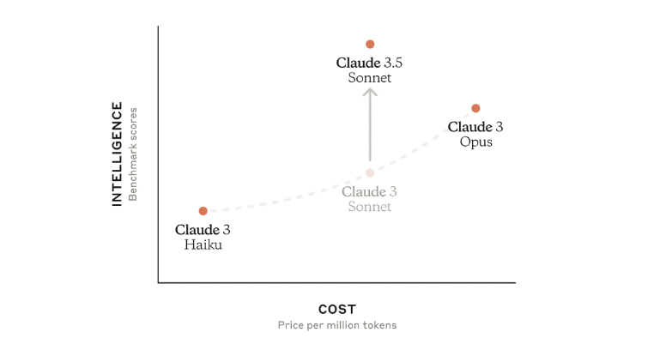
Faster
SPEED
Slower
Notes:
https://www.anthropic.com/news/claude-3-5-sonnet

Slide 4
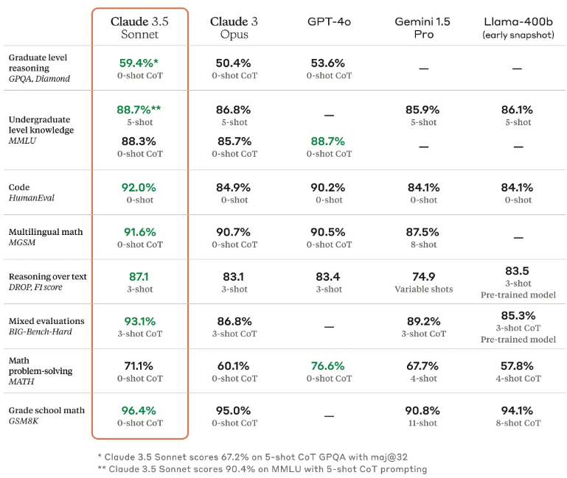
Notes:
https://www.anthropic.com/news/claude-3-5-sonnet

Slide 5
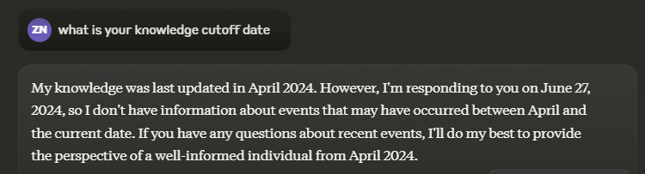

Knowledge Cutoff Date
Notes:
https://console.cloud.google.com/vertex-ai/publishers/anthropic/model-garden/claude-3-5-sonnet?project=gen-lang-client-0694848451

Slide 6
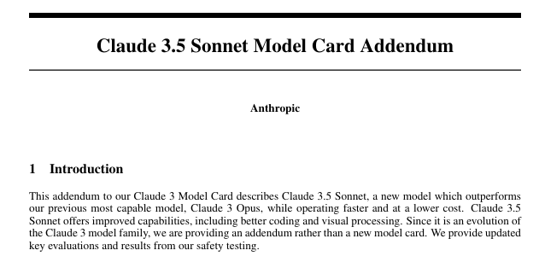
Model Card Information
Notes:
https://www-cdn.anthropic.com/f2986af8d052f26236f6251da62d16172cfabd6e/claude-3-model-card.pdf

Slide 7

Getting Help

Slide 8
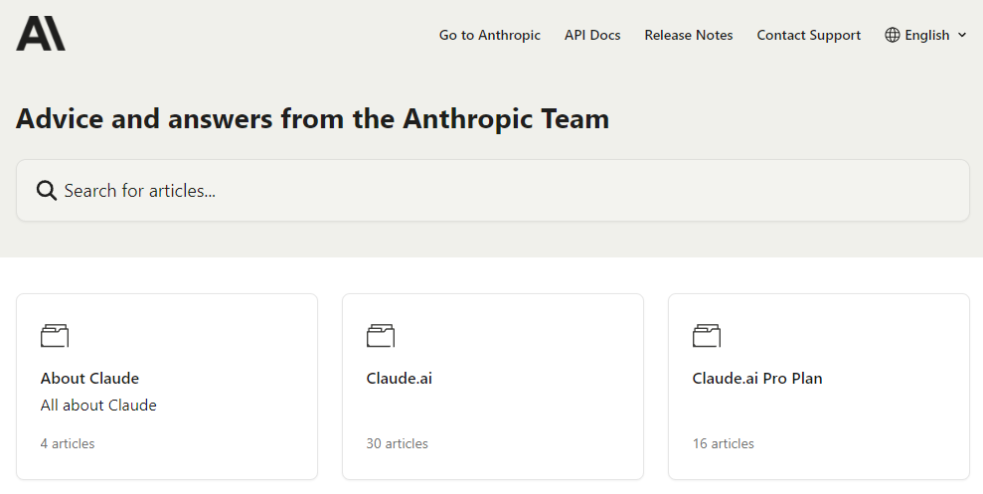
Notes:
https://support.anthropic.com/en/

Slide 9

Getting Anthropic Claude 3.5 Sonnet Pro

Slide 10
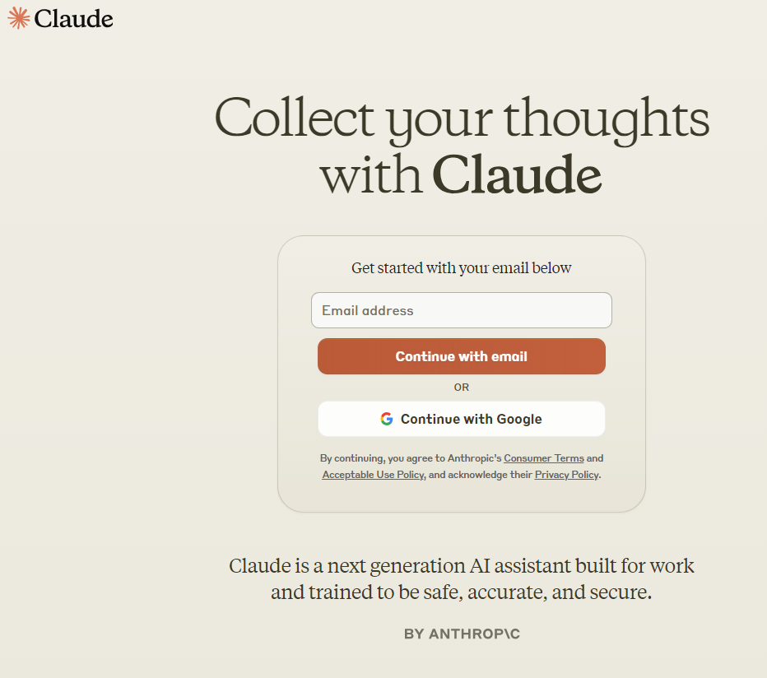
Anthropic Claude 3.5 sonnet
Notes:
https://claude.ai/

Slide 11
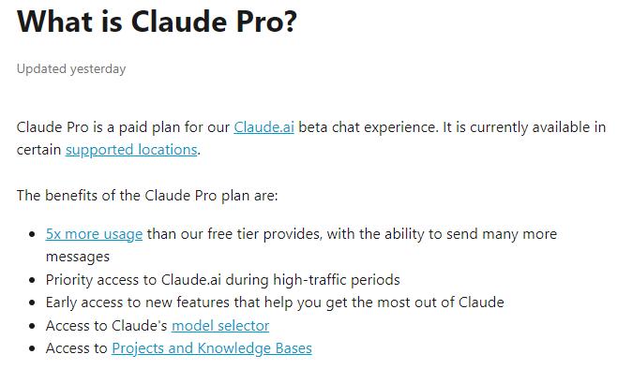
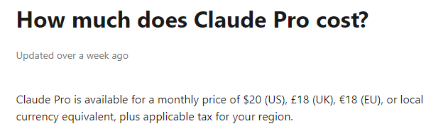
Notes:
https://support.anthropic.com/en/articles/8325606-what-is-claude-pro

Slide 12
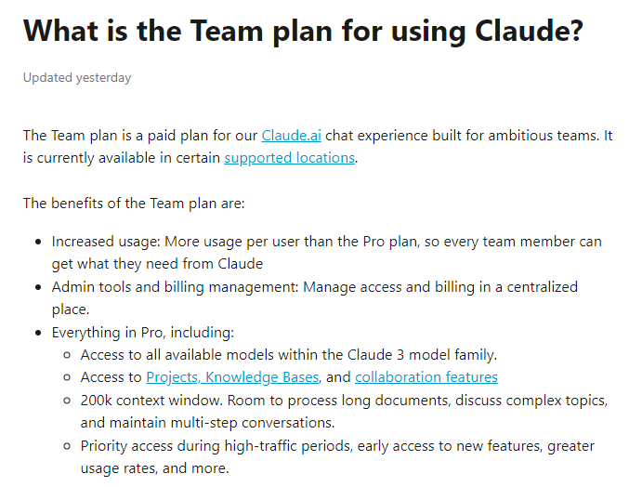
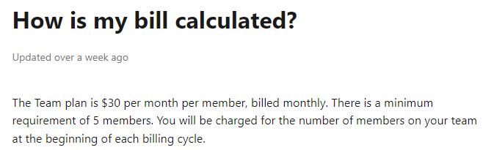
Notes:
https://support.anthropic.com/en/articles/9266767-what-is-the-team-plan-for-using-claude
https://support.anthropic.com/en/articles/9267289-how-is-my-bill-calculated

Slide 13

Limitations
Notes:
https://support.anthropic.com/en/articles/8324991-about-claude-pro-usage

Slide 14
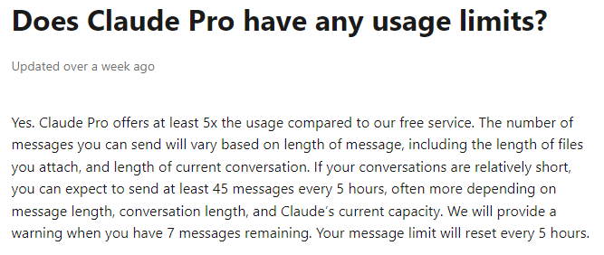
Notes:
https://support.anthropic.com/en/articles/8325612-does-claude-pro-have-any-usage-limits

Slide 15
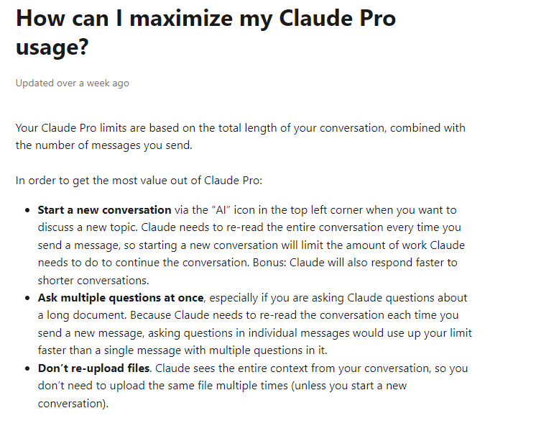
Notes:
https://support.anthropic.com/en/articles/8325614-how-can-i-maximize-my-claude-pro-usage

Slide 16
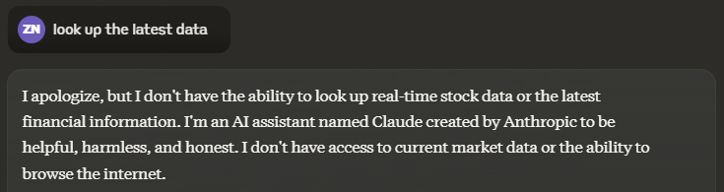
Internet Access

Slide 17
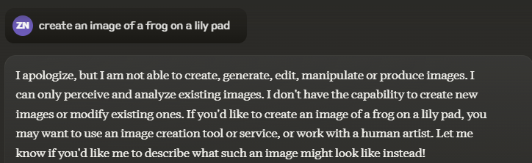
Create Images

Slide 18
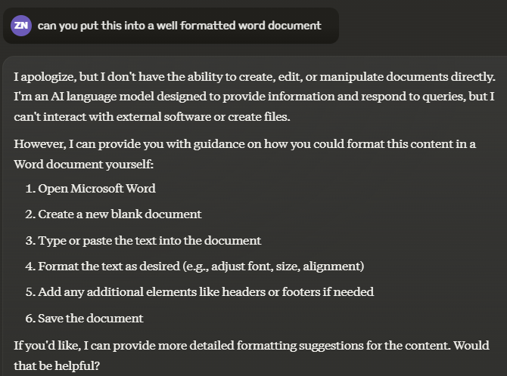
Create Documents

Slide 19
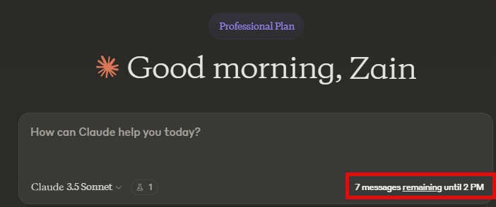
Do Not Use for Extended Work Sessions

Slide 20

Exploring the interface

Slide 21
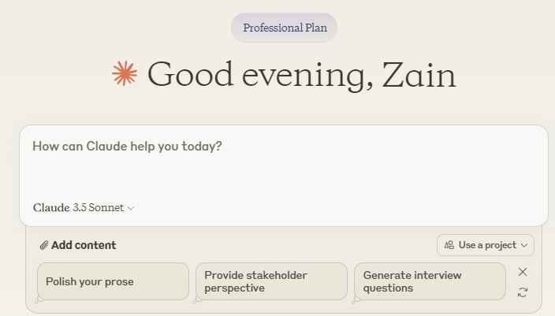

Slide 22
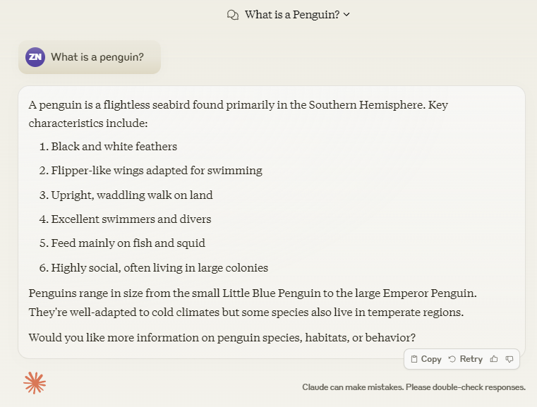

Slide 23
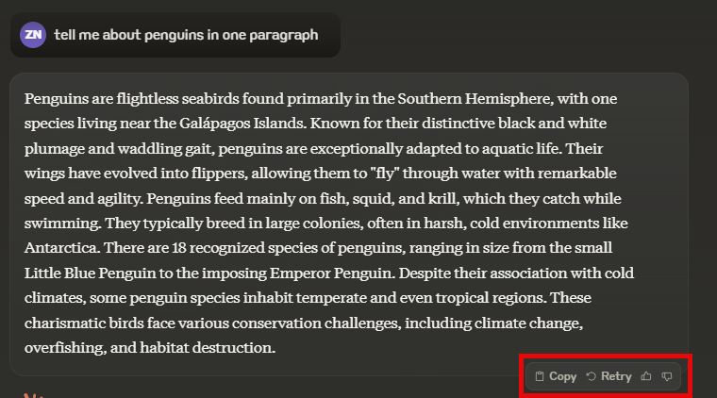
output options

Slide 24
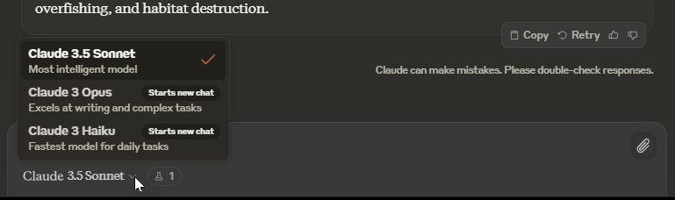
Knowing when to switch models
Notes:
What is a penguin?

